Slide 1



TG SWITCH CHIOT 2018
PROMO date: 07/12/2017
SWITCH PUPPY
CODE ONE NAV:
X010 0262
13 076-1

Slide 2
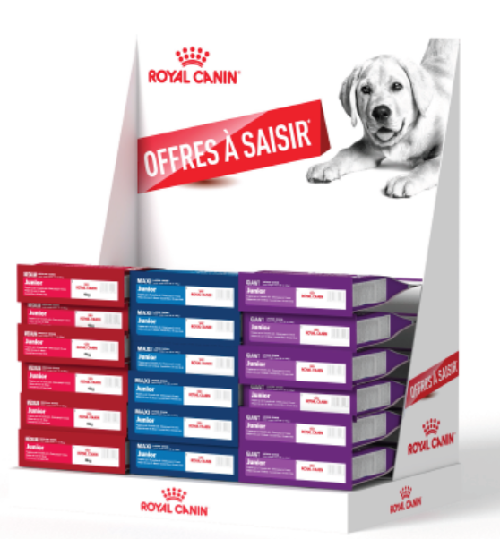
PODIUM SWITCH CHIOT 2018
PROMO date: 07/12/2017
SWITCH PUPPY
CODE ONE NAV:
X010 0263
13 076-1

