Slide 1
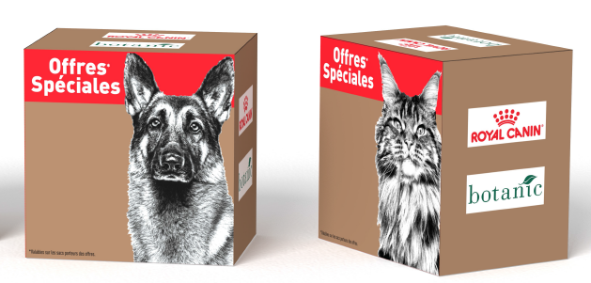
PROMO P5/2017
CODE MINOS :
N00464
CODE ONE France
X001 0286
Lot 2 Cubes Botanic

